Slide 1
Next Hikes IT Solutions
Vincy Mehta
Retail Exploratory Data Analysis

Slide 2
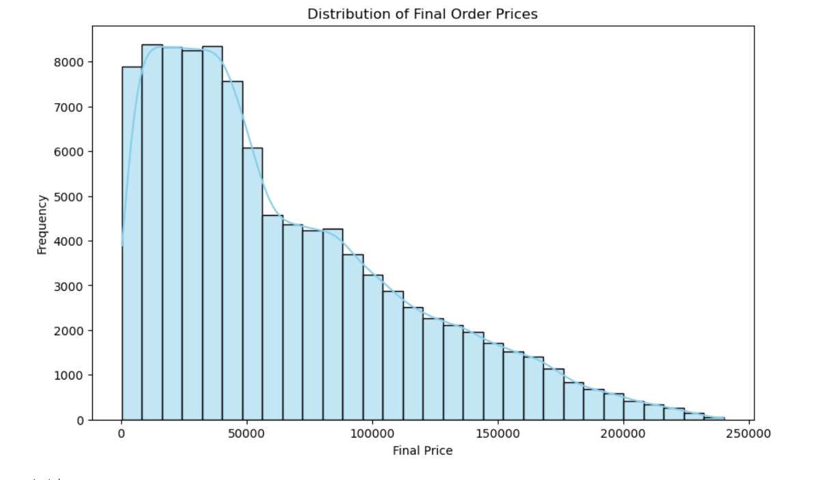
Insights :
Above chart shown Frequency of Final Price.
The frequency peaks and stays consistently high (above 7,500 orders) until the 50,000 mark.
While these high-value orders (above 150000) are rare, they represent a "Premium" segment. The gradual decline (rather than a total stop) after 100000 shows that your brand can support high-ticket items.
There is an opportunity to convert more of your "mid-tier" customers (50000–100000) into "high-tier" customers (150000) through targeted upselling.

Slide 3
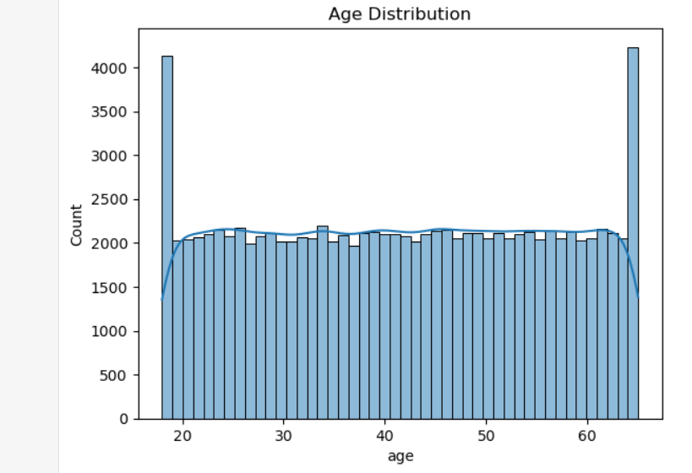
Insights :
The Age Distribution histogram shows a remarkably uniform spread across the 20 to 65 age range, with two very distinct spikes at the boundaries.
Your business successfully attracts customers of almost every age group equally, from young adults (20s) to seniors (60s).
There is a massive spike at the age 20 mark, with counts reaching over 4,000 nearly double the average of other ages. This represents a huge entry-level user base with high long-term lifetime value.
A similar spike occurs at age 65.

Slide 4
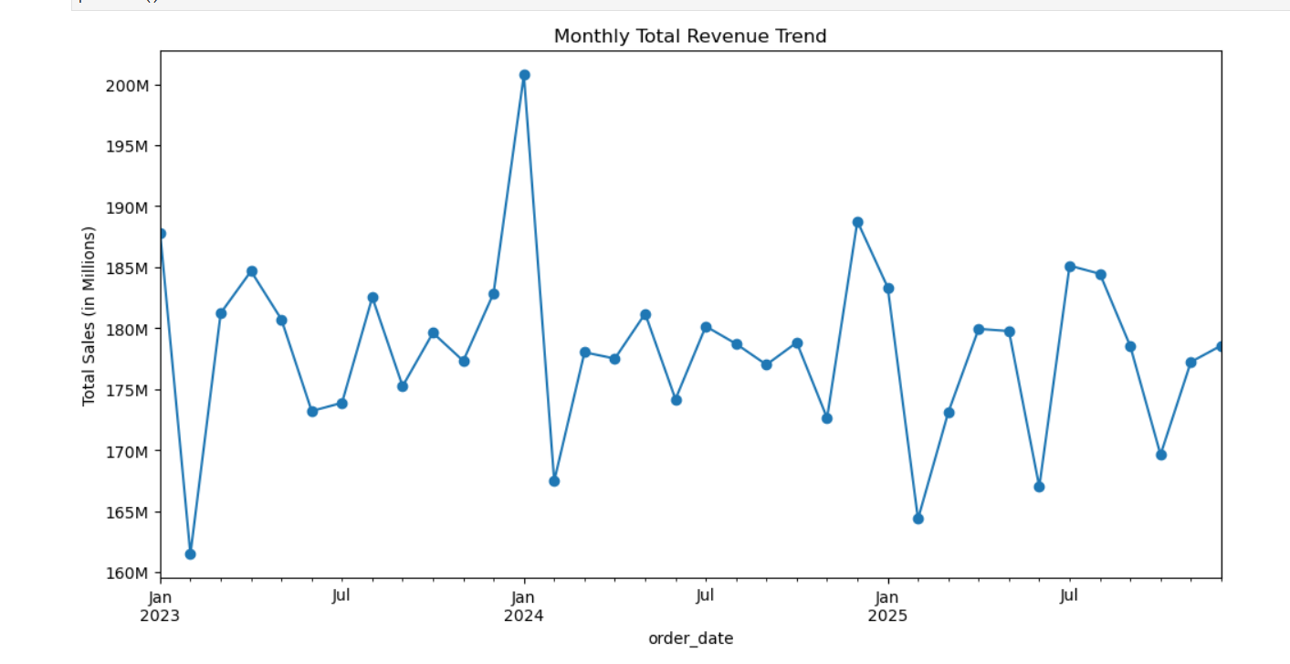
Insights :
Above chart shown month wise total sale.
In January 2024, revenue reached its highest level 200M sale. This could potentially be the result of a New Years sale or holiday season impact.
Your monthly revenue consistently stays within a high-performance band of 160M to 200M.
The chart shows significant "zig-zag" fluctuations. Sales are not steady, meaning the business relies heavily on specific events or monthly cycles rather than consistent daily growth.
Your normal monthly sales target should be at least $180M. Anything less means the business is underperforming.

Slide 5
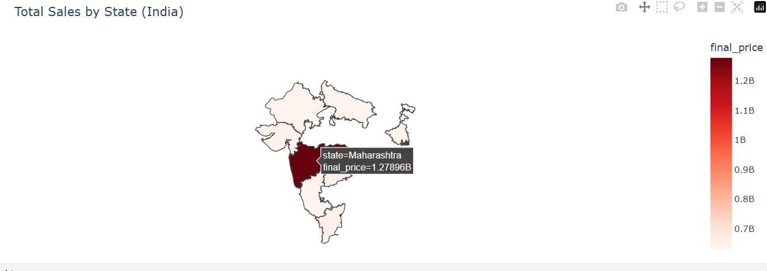
Insights :
Above chat shown State wise Total sales, the hover effect shows the State and Final Price.
Maharashtra shows the highest sales (over 1.27 Billion), outperforming all other states significantly. It is your primary revenue generator.
There is a balanced and strong sales performance across South India (Tamil Nadu, Telangana, Karnataka).
Excluding Maharashtra, the next 7 top states are performing within a very tight range of 634M to 648M. This indicates a highly stable and predictable demand for your products across different states.

Slide 6
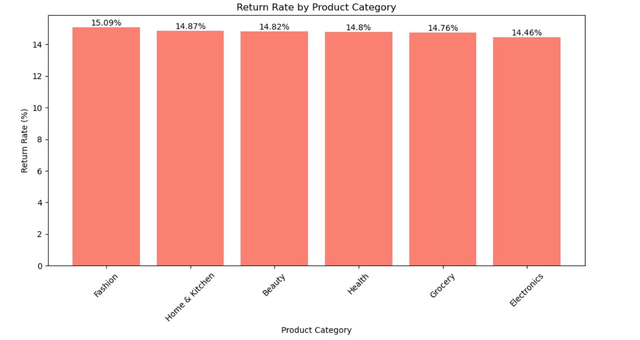
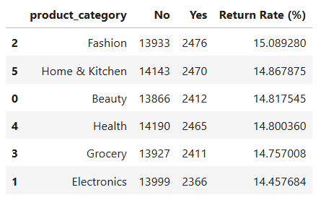
Insights :
Above chart shown Return rate(%) by Product Category.
Across all categories, the return rate is very stable, staying between 14.4% and 15.1%.
Fashion has the highest return rate at 15.09%. While this is common in the industry (due to sizing or style issues), it is your "weakest link" regarding returns, To reduce this, consider improving size guides or adding more customer reviews with photos.
Electronics has the lowest return rate at 14.46%. This suggests that customers are generally satisfied with the products they receive and they match their expectations.

Slide 7
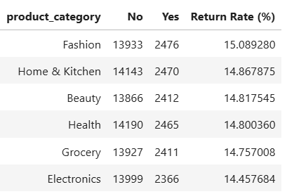
Insights :
Above chart shown Return rate(%) by Product Category.
Across all categories, the return rate is very stable, staying between 14.4% and 15.1%.
Fashion has the highest return rate at 15.09%. While this is common in the industry (due to sizing or style issues), it is your "weakest link" regarding returns, To reduce this, consider improving size guides or adding more customer reviews with photos.
Electronics has the lowest return rate at 14.46%. This suggests that customers are generally satisfied with the products they receive and they match their expectations.

Slide 8
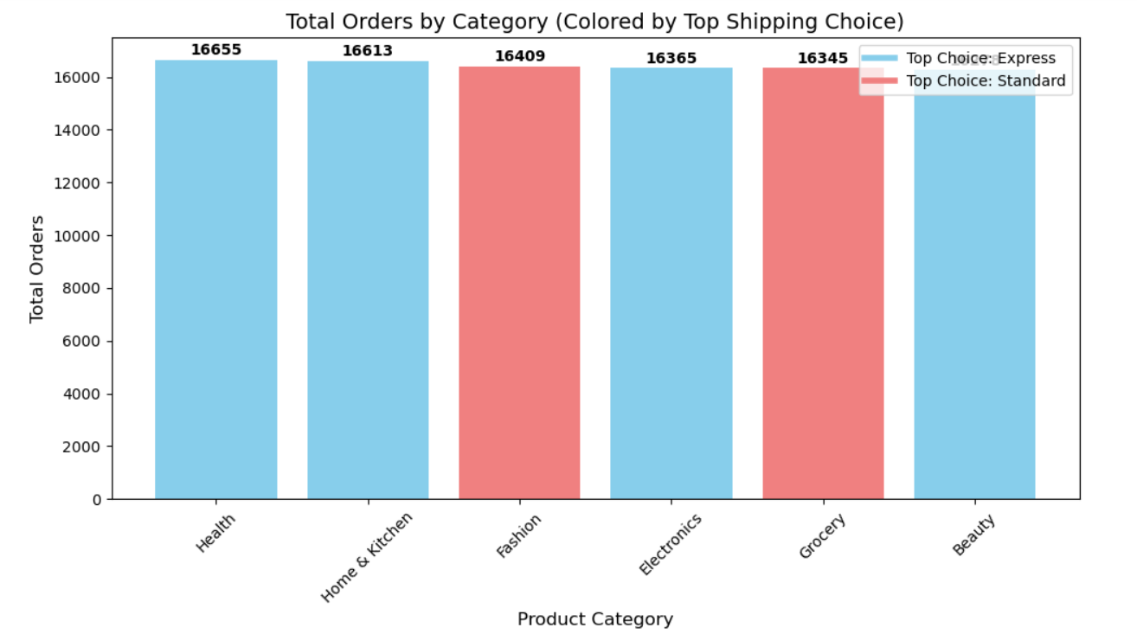
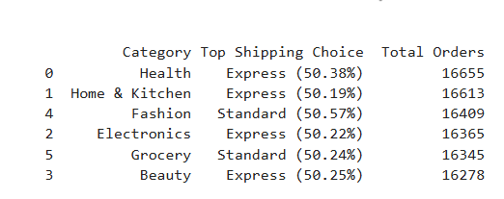
Insights :
Above chart shown Product Category and orders wise Shipping Choice.
Your total orders across all categories (ranging from 16,278 to 16,655) are remarkably similar.
Across all categories, the split between Express and Standard is almost 50/50.
In categories like Health (50.38%), Electronics (50.22%), and Beauty (50.25%), customers prefer Express shipping over standard delivery.
Fashion and Grocery shoppers are more comfortable with Standard shipping, you can consolidate these shipments to save on fuel and courier costs without upsetting the customer.

Slide 9
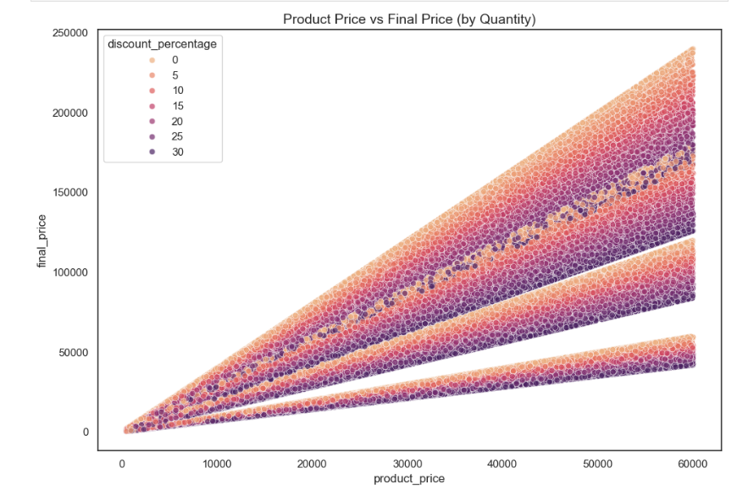
Insights :
The chart visualizes the relationship between Product Price and Final Price, segmented by Discount Percentage (colors).
There is a high density of data points between the 40,000 and 60,000 product price range. This indicates that your premium products are your high-volume movers.
This data indicates that customers are willing to purchase your products even without any discounts. This reflects a strong brand position and high customer loyalty.
The uppermost section of the graph (the Top Band) shows that even high-priced items are being sold at their full retail price. This suggests that your premium inventory maintains its value well and does not require aggressive discounting to move off the shelves.

Slide 10
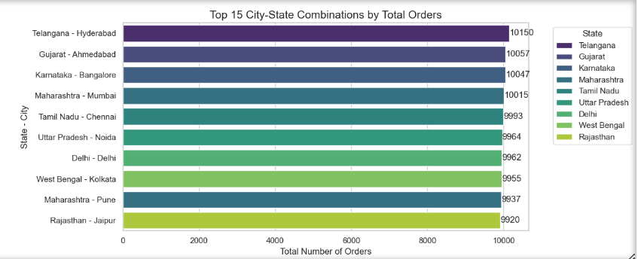
Insights :
Above chart shown Top 15 State and City wise Total Orders.
Hyderabad (Telangana) is the top-performing city, leading with 10,150 total orders.
The gap between the top city (Hyderabad) and the 10th city (Jaipur) is very small (less than 250 orders). This shows that demand is very well-distributed across all major Indian metros.
Hyderabad, Ahmedabad, Bangalore, and Mumbai are the only cities that crossed the 10,000 orders milestone.

Slide 11
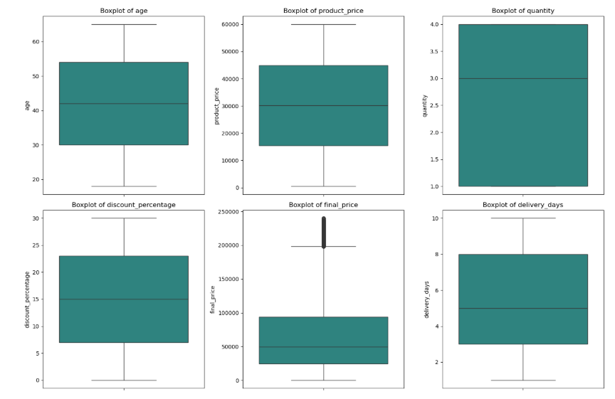
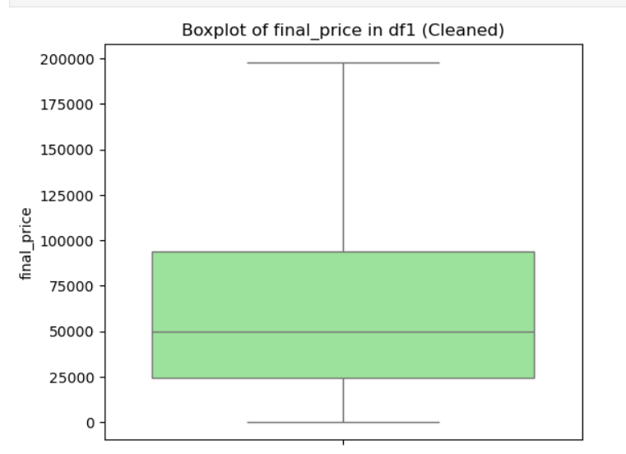
Insights :
The first image shows many outliers for final price, The second image shows the "Cleaned" version where these extreme values have been removed.
Before
After

Slide 12
Conclusion:
The brand successfully attracts a uniform age group from 20 to 65, with significant entry-level (age 20) and senior (age 65) customer bases.
Monthly revenue is healthy, staying between $160M and $200M, though it relies on "zig-zag" event-driven spikes rather than steady daily growth.
Maharashtra is the leading state in sales, while Hyderabad is the top-performing city in total orders.
High-priced premium items move well even without discounts.

Slide 13
Business Actions:
Target customers spending between 50,000–100,000 to move them toward "high-tier" (150,000) purchases.
Improve size guides and encourage photo reviews to lower the 15.09% return rate in the fashion category.
Push marketing in Gujarat and Telangana to reach the same "Deep Blue" high-sales level as Maharashtra.
While demand is well-distributed across metros like Hyderabad and Mumbai , the small gap between the top 15 cities suggests you should expand marketing to Tier-2 cities in states like Rajasthan and West Bengal to find new growth.

